Slide 1

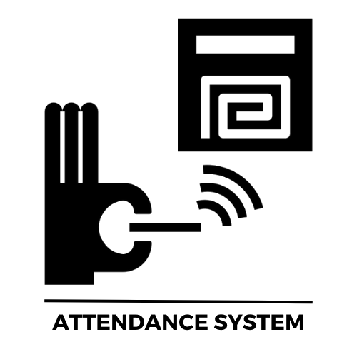

Attendance System
By:
Charbel Bachaalany

Slide 2
Table of Contents
1.
2.
3.
4.
Introduction
- Overview
- Objectives and Explanation
5.
Results
- Outcomes
- Screenshots
Project Components
- Main hardware
- Diagram
- Full Board
6.
Future Enhancements
- Potential future enhancements
- Highlight areas of future development & expansions
Code Overview
- Main fuctionalities
- Code snippets
7.
Conclusion
- Summary
User Interface
- Screenshots of the GUI

Slide 3
The RFID Attendance System is a Python-based application that utilizes RFID technology to record attendance. The system uses an RFID reader to read the RFID tags assigned to individuals and captures their images using a webcam. The attendance data, including the timestamp and captured images, are stored in a CSV file. Additionally, the system sends confirmation emails to the participants containing their attendance details and the attached photo.
1. Introduction

Slide 4
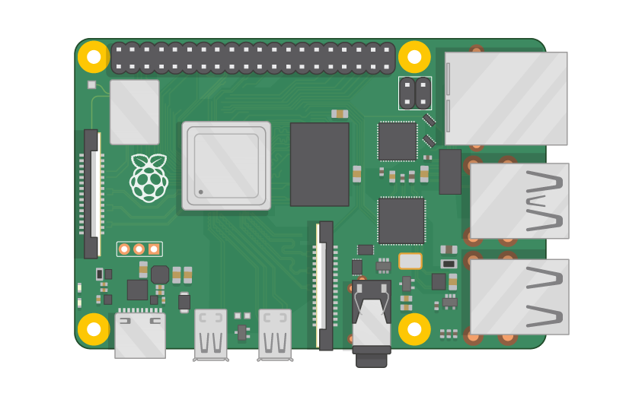
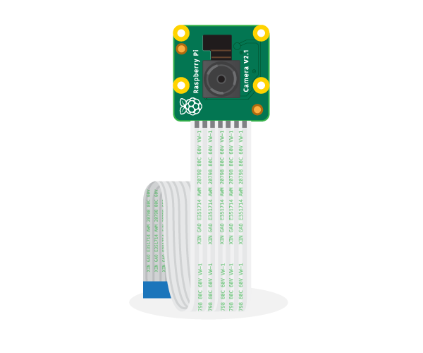
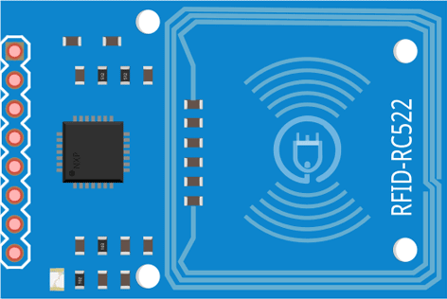
2. Project Components Main Hardware
Model 1 Camera – 5mp
RFID – RC522
Raspberry Pi 4 model B – 4GB

Slide 5
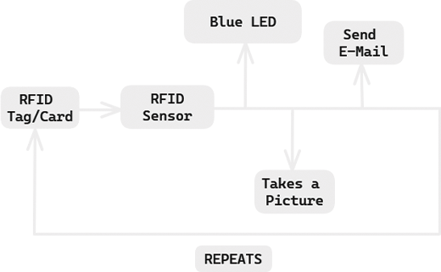
2. Project Components Diagrams

Slide 6
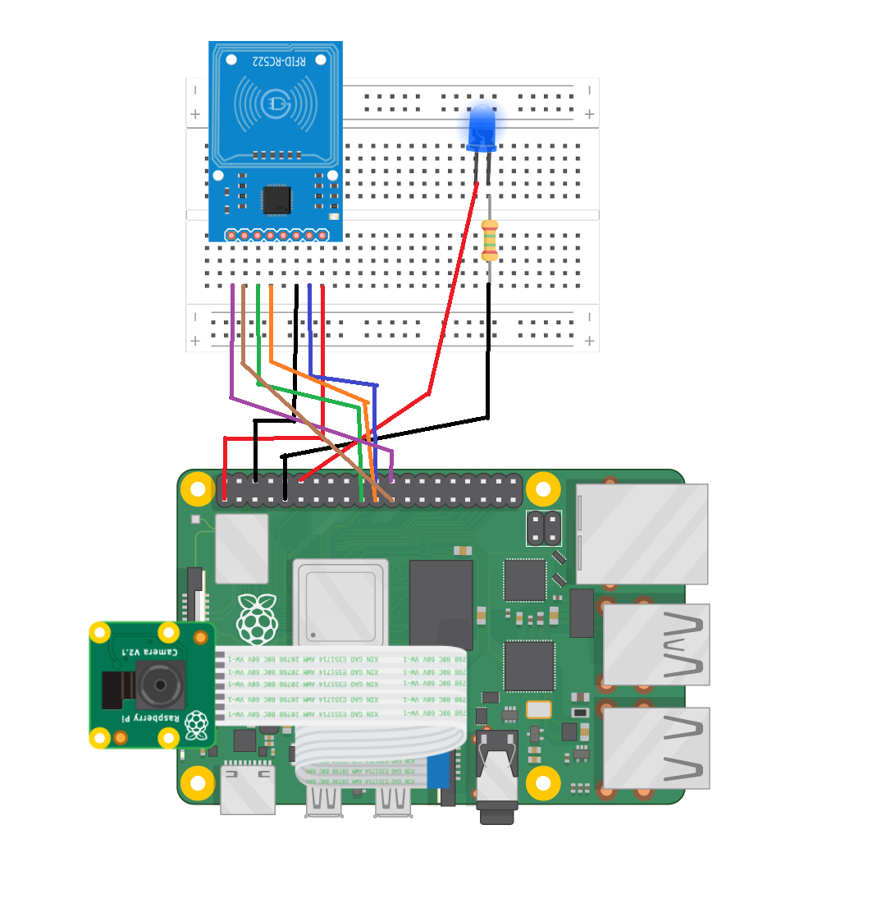
2. Project Components FULL BOARD

Slide 7
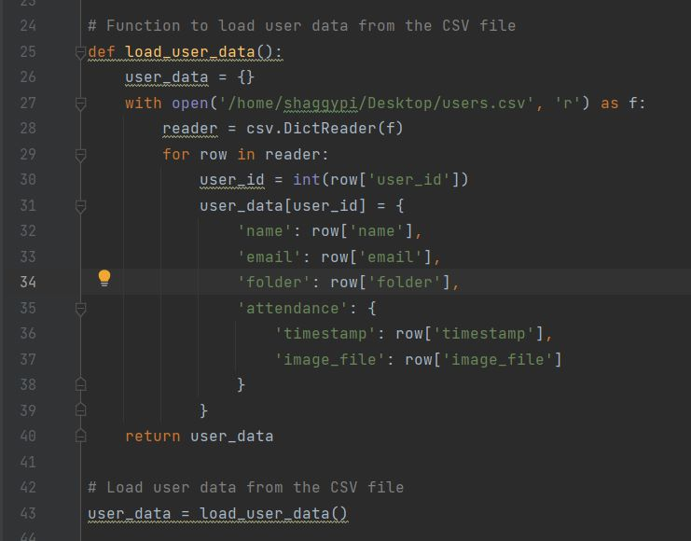

3. Code Overview

Slide 8
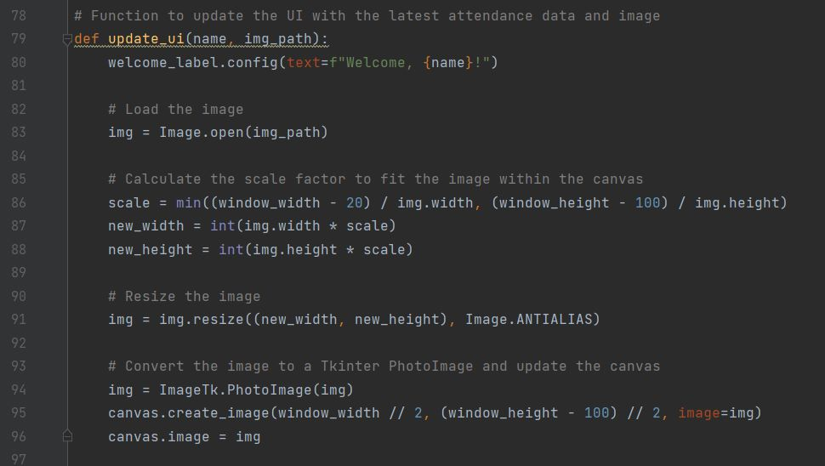
3. Code Overview – cont’d

Slide 9
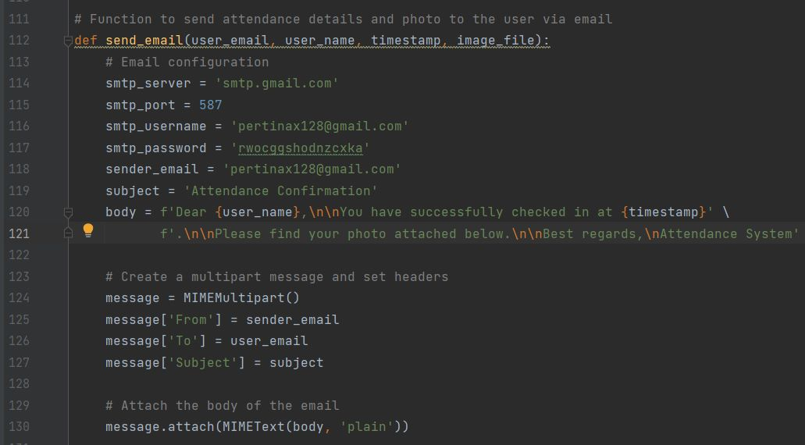
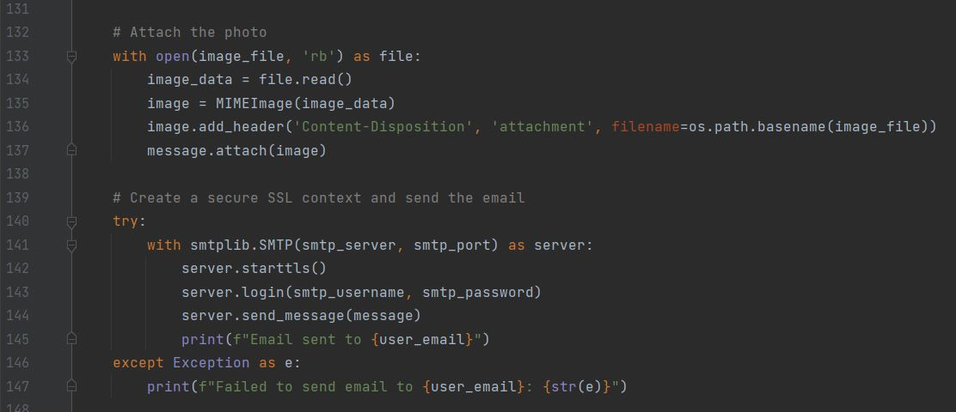



3. Code Overview – cont’d

Slide 10
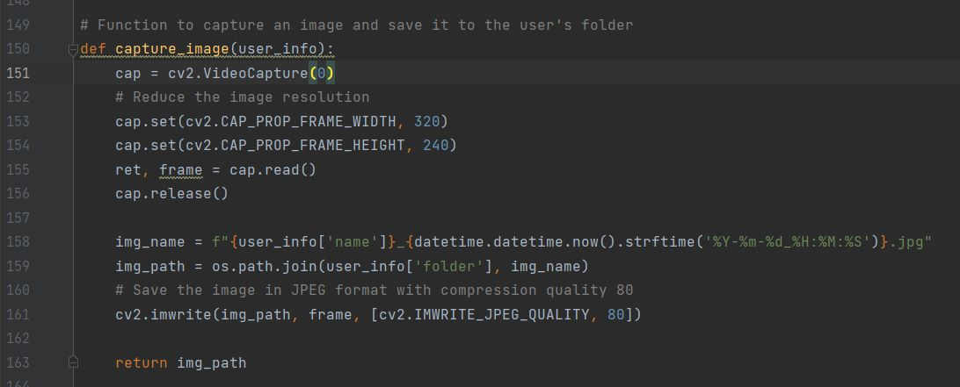
3. Code Overview – cont’d

Slide 11
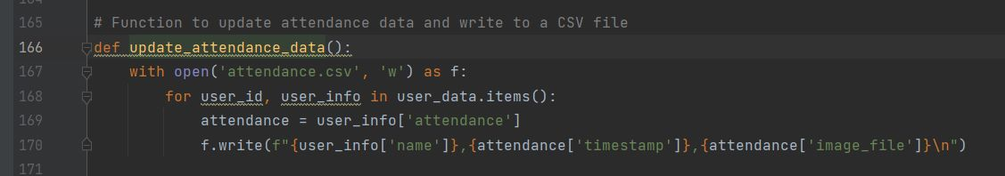
3. Code Overview – cont’d

Slide 12
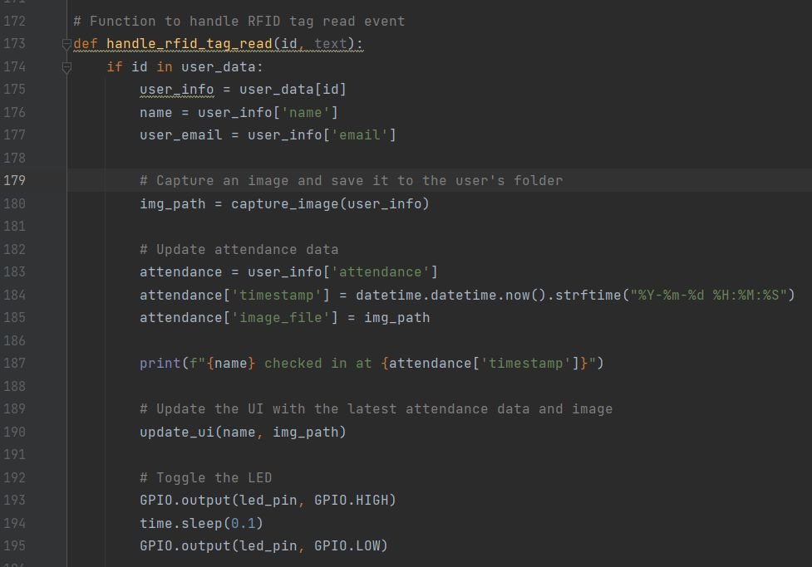
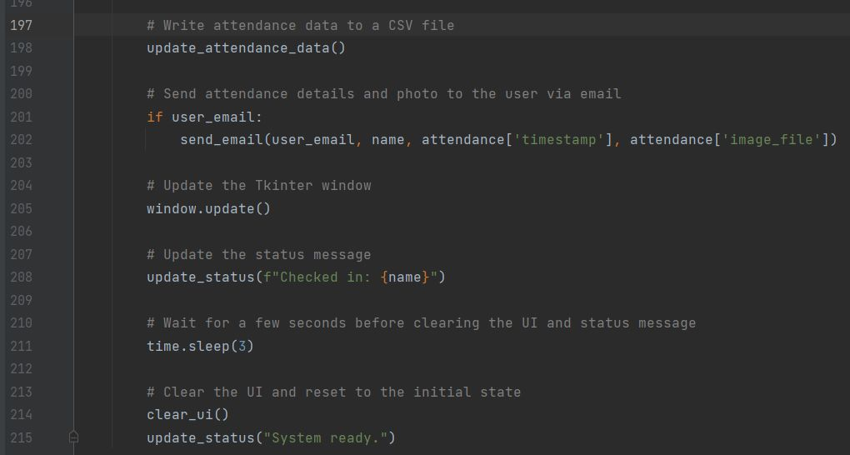
3. Code Overview – cont’d

Slide 13
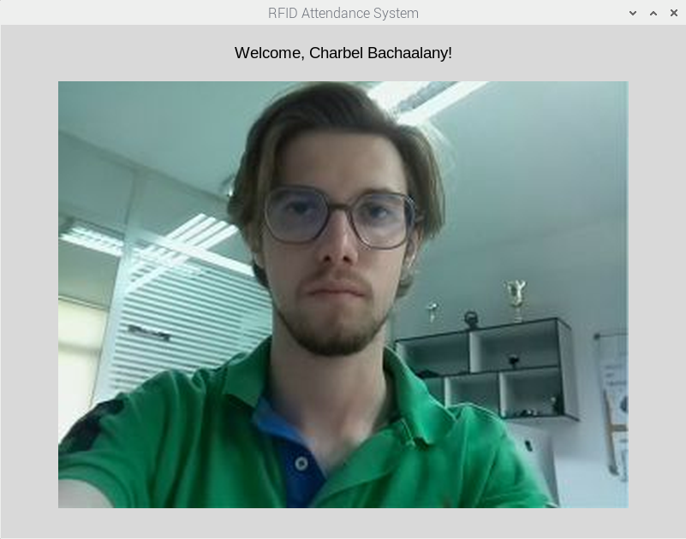
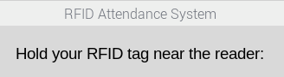
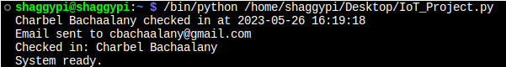
4. User Interface

Slide 14
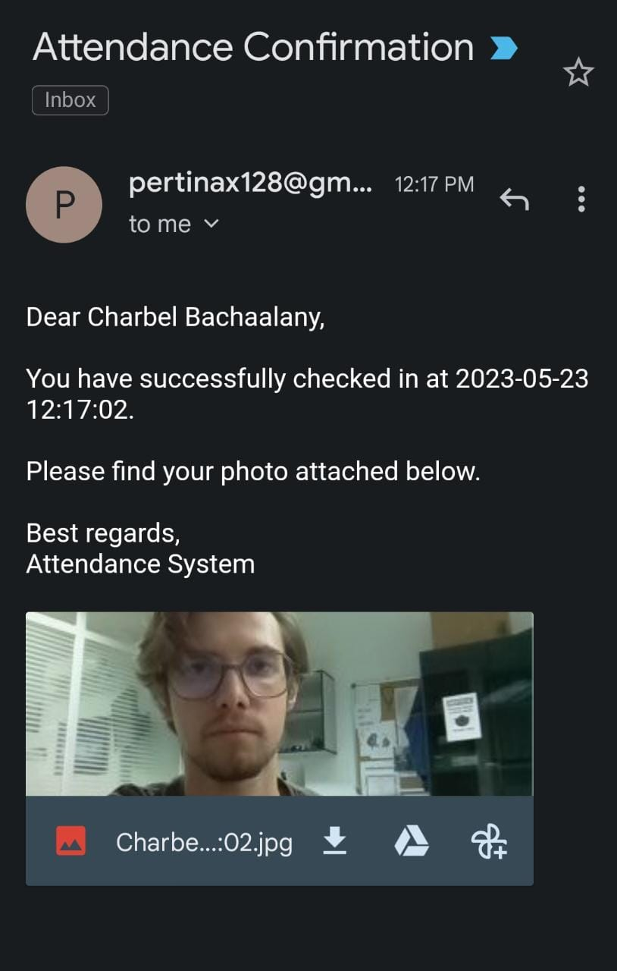
Successfully created a folder for each user.
5. Results
Saves user attendance history into a CSV file.
Successfully sends an email to the recipient with his checkin info – with image attached.

Slide 15
6. Future Enhancements
Adding real-time facial recognition.
If the device is tampered with is sends live stream video straight to the administrator and security.
A voice note to greet users.
2-factor authentication email.
Integration with a second RFID sensor for check-outs
Replace smtp with a proper email sending API

Slide 16
7. Conclusion
In conclusion, we successfully implemented a functioning attendance system that meets our expectation, given the limited hardware, it can also be built upon for future enhancements, the project is light weight and optimized enough so it can also be ported to the raspberry pi zero w.

Slide 17
Thanks!

